Slide 1
Creating a Web Site Design
constructing the look and feel
Notes:
This lecture begins by examining the essential questions must be asked at the start of any SharePoint 2010 branding project such as what will be the target screen resolution and which browsers will be supported and need to be integrated into the testing phase. The lecture will also cover the why and how of creating important design documents such as wireframes and design comps. There will also be a discussion of using slices in a professional design tool such as Adobe Photoshop or Microsoft Expression Design to generate image files that will be used to implement the final Web site design. The lecture concludes with a discussion of how to create an initial page layout using HTML and CSS that meets the requirements of your project.

Slide 2
Agenda
Project Planning
Creating a Wireframe
Creating a Design Comp
Moving the Design into HTML and CSS

Slide 3
Planning
Common Questions
What version of SharePoint 2010 are we using?
What type of website are we designing?
What browsers do we plan to support?
What screen resolutions should we design for?
What type of content are we going to display?
What SharePoint elements should be included?
Notes:
You should know which version of SharePoint 2010 because different versions offer different levels of functionality especially in the area of branding.
You should know what type of website you are we designing. For example, are you designing a intranet site for corporate employees or a publically facing site on the Internet targeting potential customers
You must decide what browsers to support so you can design your HTML and test your pages appropriately. Unless you can make the assumption that all you users are using Internet Explorer, at a minimum you should test all your pages using Firefox.
You should decide on a minimum supported screen resolutions early. Many aspects of a Website design are dependent upon this decision.
Deciding what type of content and how much content to show per page is also important to decide early. You should also move through the standard set of SharePoint page elements to decide which ones to include and which ones to omit in your design.

Slide 4
SharePoint Editions
SharePoint Foundation is the free version of SharePoint
Supports collaboration, documents and wiki web pages
Sites created as Team sites and Blank sites
SharePoint Server 2010 is licensed version of SharePoint
Includes many features including Publishing
Better platform for creating branded websites
Notes:
Some SharePoint 2010 farms will be running SharePoint Server 2010 while other will only be running SharePoint Foundation. Do you need to provide branding for sites running in both types of farms or only one of them? For example, you must be using SharePoint Server 2010 if your design involves the use of publishing sites. If you know you will be branding sites running in SharePoint Foundation farms, you will have to support branding team sites which involves more work.
Here is the bottom line. You must decide whether the scope of your branding project will include team sites or publishing sites or both.

Slide 5
Categories of SharePoint Websites
Intranet Sites
Usually targets employees
Extranet Sites
Usually targets contractors, vendors and partners
Internet Sites
Often targets customers
Designed with cross-browser support and wide-reach
Designed to support anonymous access users
Notes:
Most intranet sites target employees who access the site using their Active Directory accounts. In most cases the requirements of branding are lower and there is no need to worry about the appearance of the site to an anonymous user.
Extranet sites often target contractors, vendors and partners. The branding requirements are often greater because it is important to convey a clear company identity (i.e. brand) to outside parties. However, like an intranet site you usually do not have to worry about the appearance of the site to an anonymous user.
Internet sites usually have the highest level of requirements for a branding project. They need to look as polished and as professional as possible to convey a strong company identity. After all, these types of Websites are are seen by customers and other folks who are potential customers. Furthermore, most Internet sites must be designed with anonymous access as the primary means in which users will view the pages of the site. This requires extra attention when branding SharePoint sites.

Slide 6
What Browsers Should You Support?
Notes:
In limited scenarios such as a corporate Internet you might be able to make an assumption such as all user will be using the same version of the Internet Explorer such as Internet Explorer 8. However, being able to make an assumption like this is the exception and not the norm. The graphic in the slide tells a story about today's most popular browser and devices .
If you are creating an Internet-facing site, you should anticipate users will be accessing your site with FireFox, Chrome, Safari and Opera in addition to Internet Explorer. At a minimum, you should test all your work using FireFox in addition to Internet Explorer. For important pages such as those with shopping cart functionality, you should perform testing with a wider array of the browsers shown above.

Slide 7
Selecting a Target Screen Resolution
What resolutions are used by potential users
Can be as small as [800 x 600]
Can be as larger as [1920 x 1200] or more
Design should be based on minimum resolution
[1024 x 768] is most common for today’s designs
[1280 x 800] is also a popular choice for a design
Notes:
A common newbie mistake is to design Web pages optimized for a high resolution monitor such as one with the dimensions of 1920 x 1200. The design looks great on the designer's brand new monitor but if gets cut off and looks horrible on 90% of the screens used to surf the Internet. On the other hand, you don't want to design for the monitor resolutions from the 1990s such as 800 x 600. A design that shows all the required content on a 800 x 600 resolution screen often looks like a postage stamp on a 1920 x 1200 resolution screen and might require the user to use a magnified glass to see the page content
It is important to select a minimum supported resolution for a page design. This minimum resolution will be used to design pages and should also be used early and often for testing. The two most popular choices today for the minimum supported resolution at 1024 x 768 and 1280 x 800 due to the known statistics about the screen resolutions used by Internet users.

Slide 8
Deciding What Type of Content To Display
Making decisions about site content
What type of content will be included?
How much content will be displayed?
How should the content be organized and presented?
Design should include information architecture
Blueprint for how content is stored and organized
Design should enabled users to find desired content
Information architecture significantly affects navigation
Notes:
Early in the design phase you should try and make decisions or force the stakeholders with authority to make decisions about the type of content that will be shown on pages. For example, will content be shown in lists or in tables? Will the content include icons or other graphic images? Will the content consist or 2 to 3 paragraphs per page or will some pages have long passages requiring the user to scroll down 3 or 4 times to get to the bottom of the page.

Slide 9
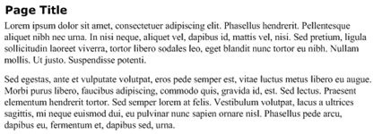
Content Greeking
Greeking is often used to mock up pages
Placeholder content created using Latin
Helpful to concentrate fully on layout and formatting
Lorem.com is a site dedicated to greeking
Notes:
When designing a site, you need pages full of content so you can create the page content and begin formatting it. However, the actual content for the site is rarely done at this point and you don't want to hold up the design process waiting for it. Therefore, it has become a common practice to mock up pages with fake content. By using a foreign language that is not understandable you fully concentrate on layout and the formatting. The term "Greeking" is used to refer to this practice. Ironically, greeking is usually done using Latin instead of Greek. The Website Lorem.com makes it easy to copy and paste Latin content into the pages of your site.

Slide 10
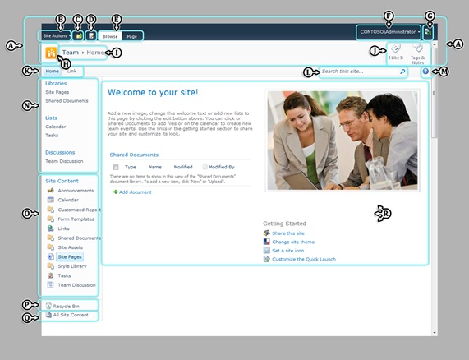
SharePoint 2010 Page Elements
A | Server ribbon
B | Site Actions
C | Global breadcrumbs control
D | Page State Action button
E | Ribbon contextual tabs
F | Welcome menu
G | Developer Dashboard button
H | Title in Title Area
I | Breadcrumb
J | Social buttons
K | Global navigation
L | Search area
M | Help button
N | Quick Launch
O | Tree View
P | Recycle Bin
Q | All Site Content
R | Body area
Notes:
Server ribbon: The entire top portion of the page. What is displayed depends on the user's current context.
Site Actions The main menu for interacting with SharePoint, used primarily by content authors and administrators.
Global breadcrumb : Drop down menu showing hierarchical view of the site used to navigate up levels of the hierarchy.
Page State Action button: The button used to view and change page state which a shortcut to edit or save.
Ribbon contextual tabs: Tabs present contextual menus specific to the page mode and the user permissions.
Welcome menu: This menu shows log in and log out commands as will as those specific to the user.
Developer Dashboard button: The button that toggles the Developer Dashboard open and closed.
Title logo: Image button which shows the SharePoint site icon and navigates to home page of site.
Title in Title Area: This is the Title Area used in some pages which can be used to provide a breadcrumb menu.
Social buttons: Used for adding social comments and notes to content. Only enabled when User Profiles are configured.
Global navigation: Main menu of page which is sometimes referred to as the Top Link Bar.
Search area: The search box is used to enter terms for performing searches on the site.
Help button: The help button links to the SharePoint 2010 help documents.
Quick Launch: Provides navigation links around the current site. Sometimes referred to as the Current Navigation.
Tree View: Provides a Windows Explorer–style representation of the site. Not shown by default.
Recycle Bin: Provides a link to the Recycle Bin for the site where users can see and restore deleted items.
All Site Content: A link to the All Site Content page.
Body area: Represents the main content placeholder that includes all of the content that is specific to the page.

Slide 11
Agenda
Project Planning
Creating a Wireframe
Creating a Design Comp
Moving the Design into HTML and CSS

Slide 12
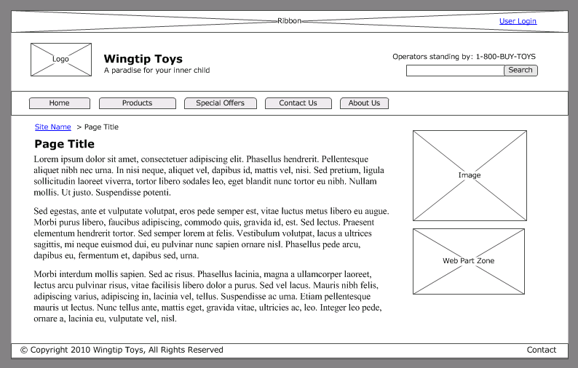
Wireframes
Skeletal page designs with layout and flow
Black and white design without color or graphics
Incudes what functionality to include and omit
Allows design decisions to be made without distraction
Notes:
A wireframe has become a very popular tool to use when designing a Website. It is created as a skeletal page design which allows you to create a layout and a flow in a black and white view which intentionally includes no color or graphics. The main idea with omitting color or graphics in a wireframe is to defer decisions in areas that often lead to time consuming debates and to commit to what elements and functionality to include and omit from each page. Design decisions can be made quickly and without distractions.
Microsoft Office Visio is a great tool for creating wireframes. There is also a popular Visio stencil available for free online known as the GUUUI Web Prototyping Stencil 3. The demo wireframe in this course has been made using this resource. The URL for this resource appears below.
http://www.guuui.com/issues/02_07.php

Slide 13
DEMO
Creating a Wireframe with Visio 2010

Slide 14
Agenda
Project Planning
Creating a Wireframe
Creating a Design Comp
Moving the Design into HTML and CSS

Slide 15
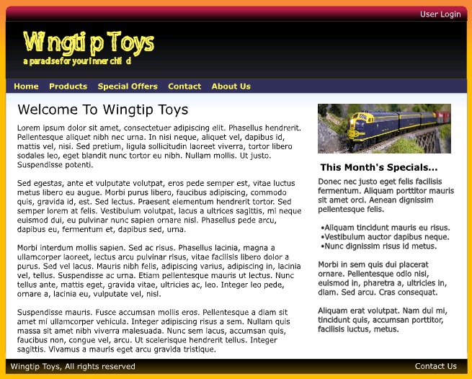
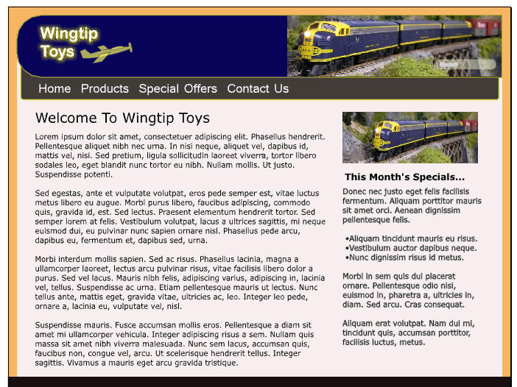
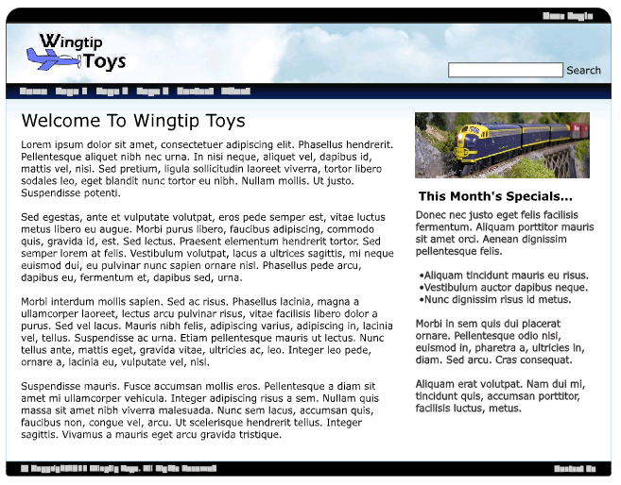
Design Comps
Visual mockup which mimics final site branding
Often created with Photoshop or Expression Design
Incudes color, fonts and images
Provides choices to stakeholders
Selection of design comp done before implementation
Design Comp 1
Design Comp 2
Design Comp 3
Notes:
A design comp is a visual mockup which is created to mimics the final look of the site branding. However, design comps do not working with HTML or CSS. Instead, a design comp is created with a design tool such as Adobe Photoshop or Microsoft Expression Design.
A design comp includes colors, fonts and images. The idea is that the designer will provide several design comps to the project stakeholders and the stakeholders are able to choose the one they like best. Quite often there will be several rounds. For example, the stakeholders might tell the designer, "we like the colors and layout of design comp #3. However, we want there to be three columns instead of two and we want a different logo in the top left corner." The designer might take this feedback and then create three more design comp choices for round two.

Slide 16
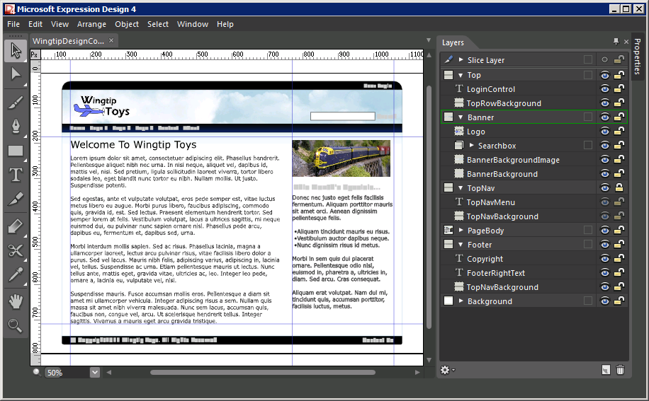
Creating a Design Comp
Popular Design Tools
Abode Photoshop (used by the pros, powerful but hard to learn)
Microsoft Expression Design (easier to learn, not as powerful)
Notes:
A design comp is usually selected and committed to before the actual implementation of the Web pages begin. However, the design comp that has been selected is often used in the implementation of page. That's because a design tool such as Photoshop or Expression Design can employ a mechanism known as "slices" to produce high quality graphic images that can be used in HTML img elements and as backgrounds with CSS.

Slide 17
DEMO
Creating Design Comps with
Microsoft Expression Design 4

Slide 18
Agenda
Project Planning
Creating a Wireframe
Creating a Design Comp
Moving the Design into HTML and CSS

Slide 19
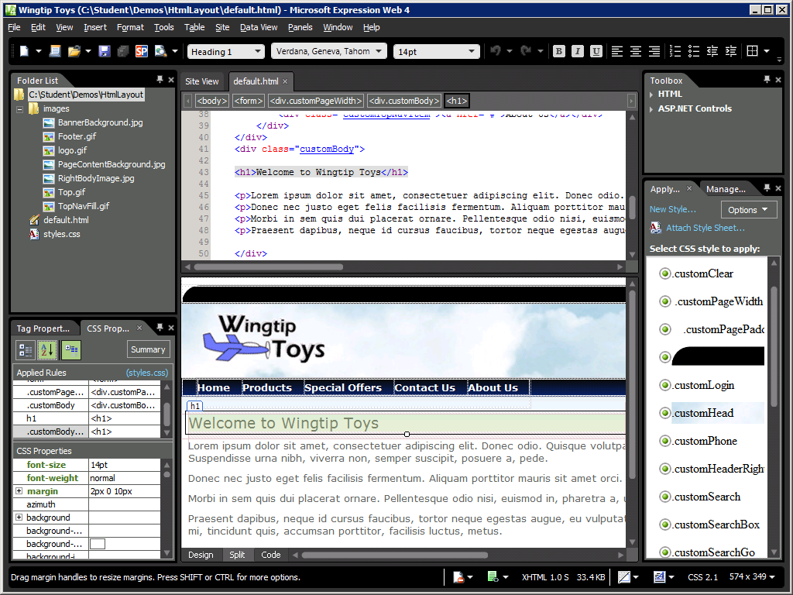
Designing with HTML and CSS
Notes:
Once you have created the main page images with a design tool such as PhotoShop, Fireworks or Expression Design, it is best to mock up a page with uses them using HTML and CSS. It can be a good exercise to create a page mockup totally outside of the SharePoint environment so you can remove unnecessary distractions as you create the basic skeleton for the layout of your pages. Once you get a mockup page looking good, then it's time to take on the challenge of integrating this basic set of HTML elements and CSS rules into a custom master page in SharePoint 2010.

Slide 20
DEMO
Mocking Up HTML Page Designs using Microsoft Expression Web 4

Slide 21
Summary
Project Planning
Creating a Wireframe
Creating a Design Comp
Moving the Design into HTML and CSS

